Slide 1

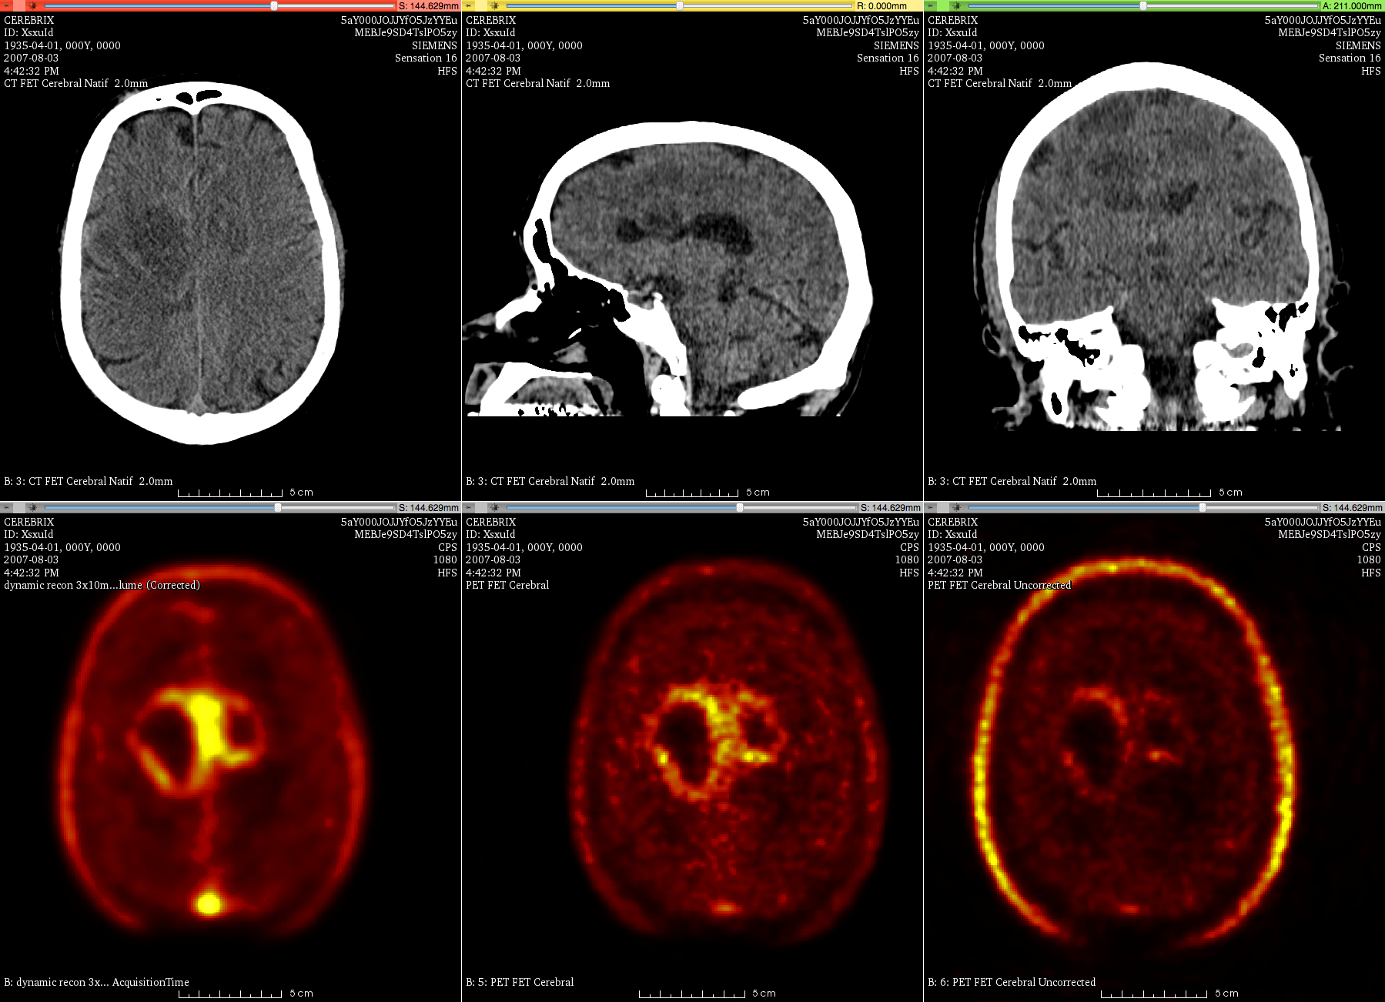
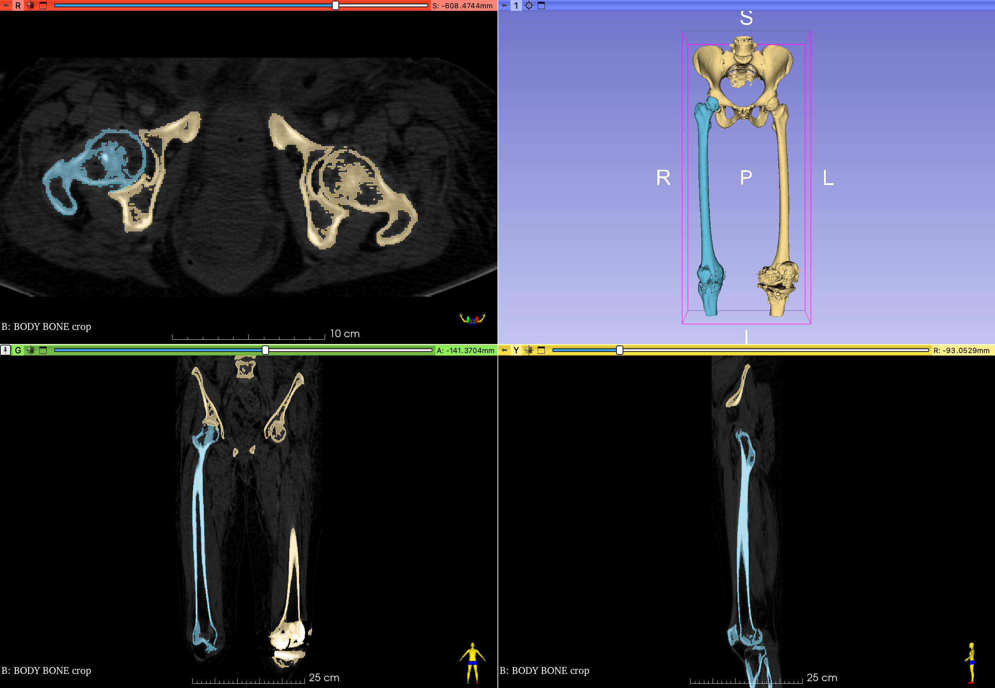
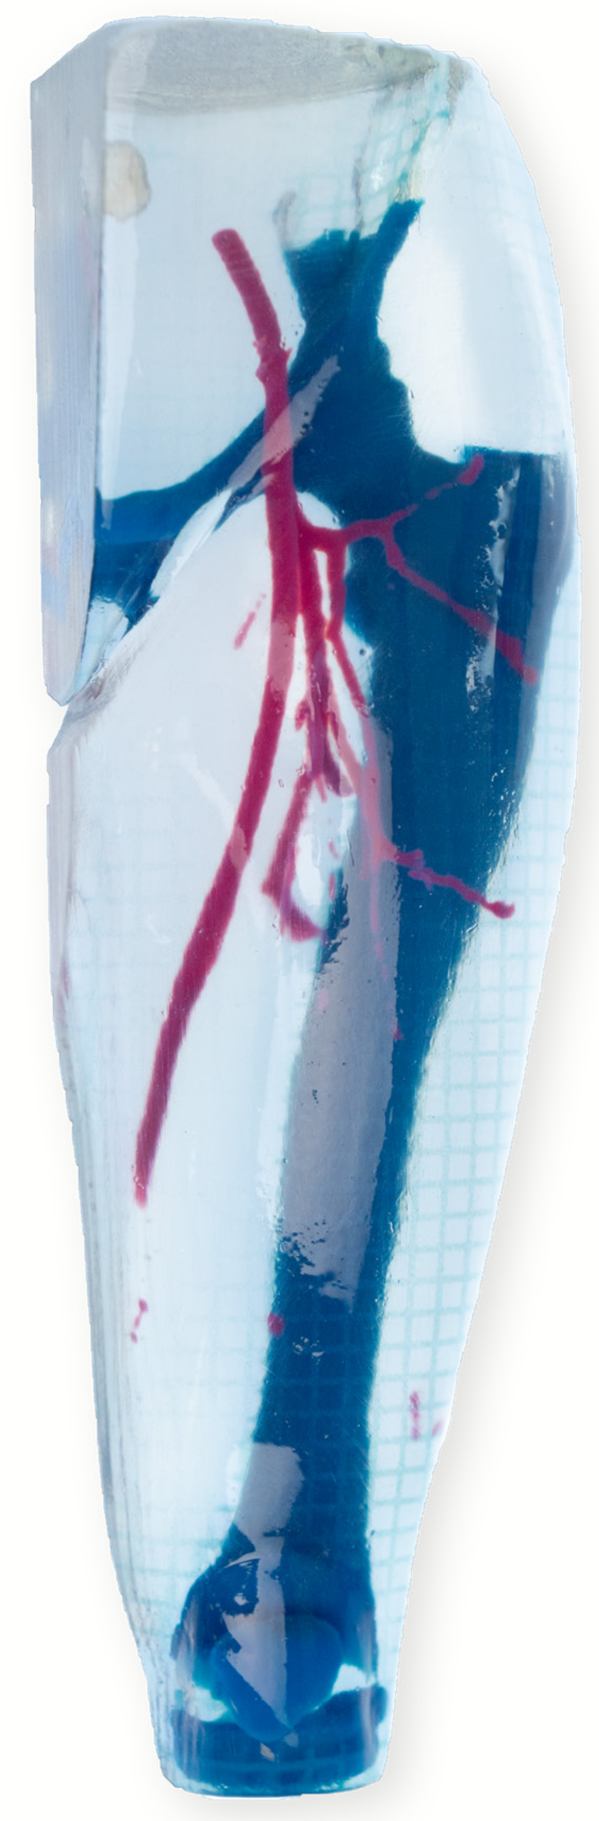
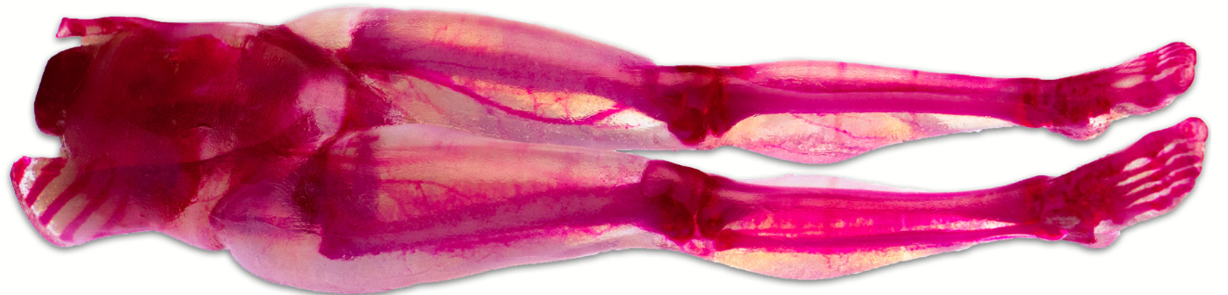
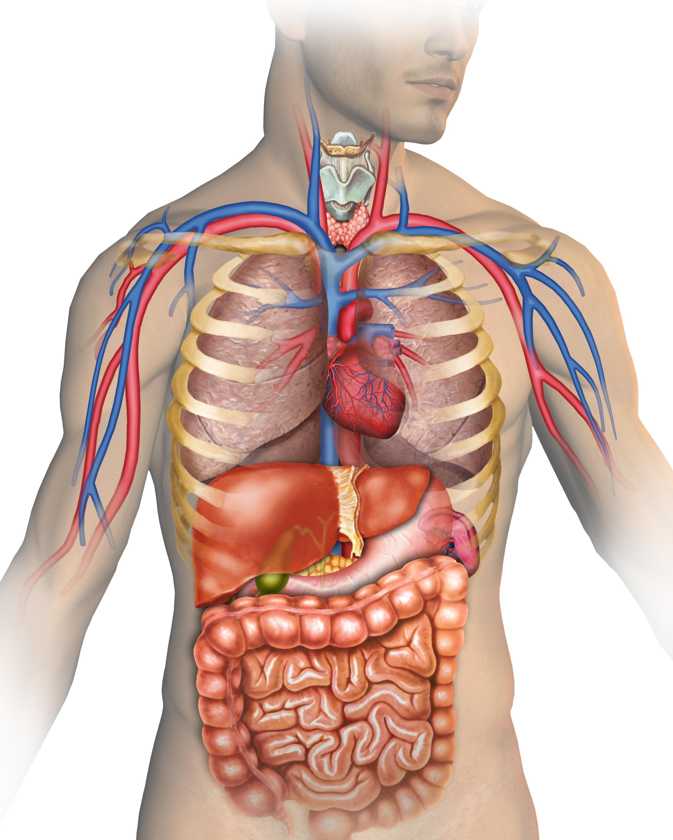
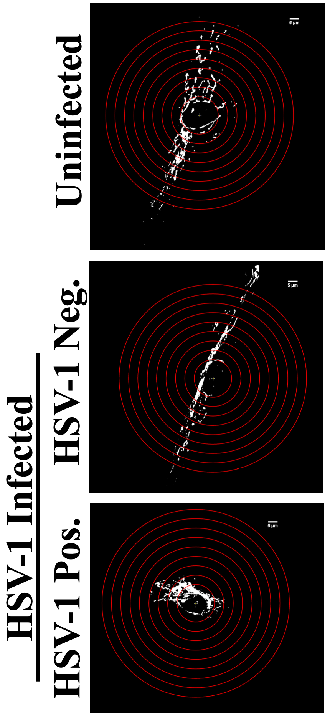
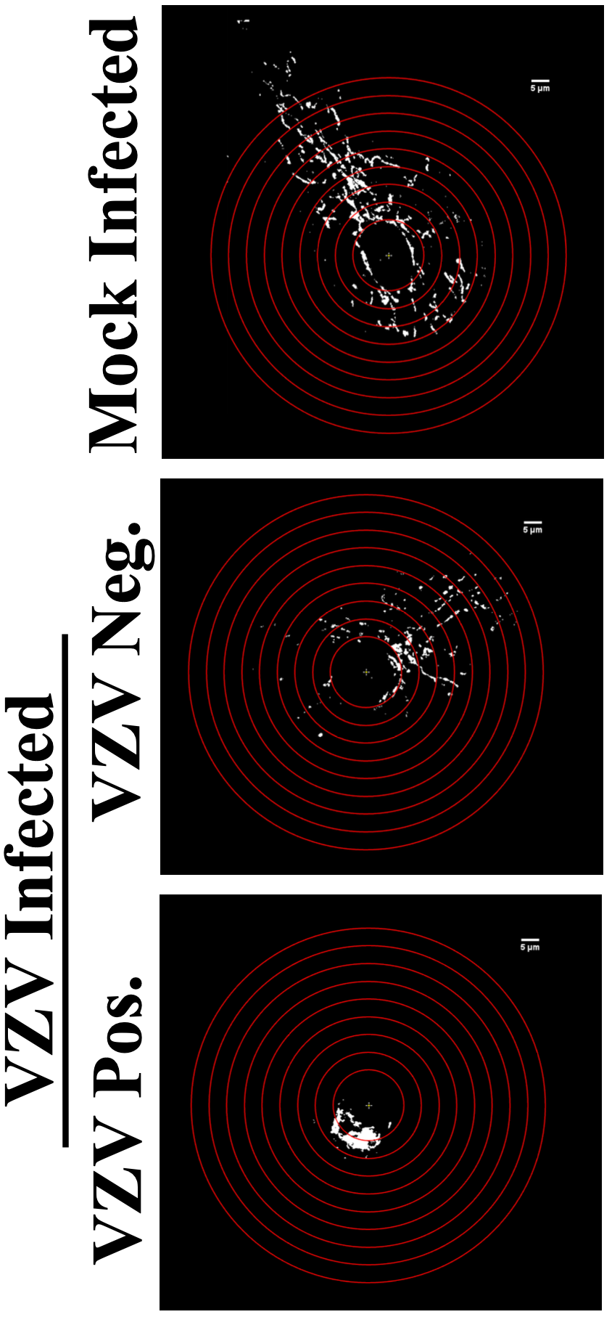
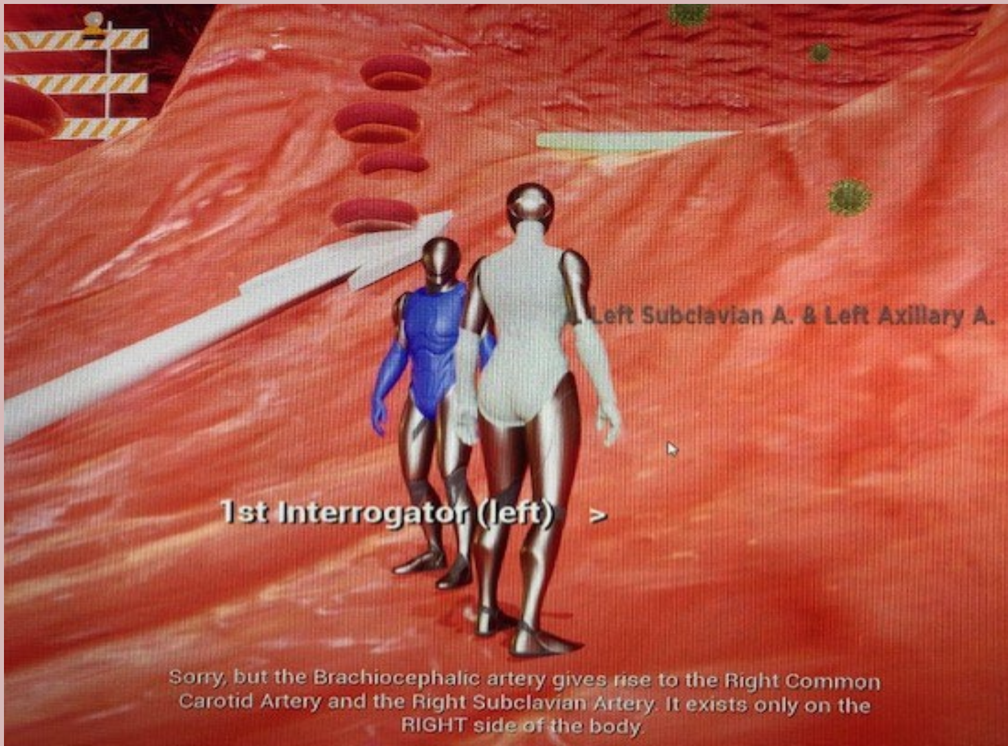

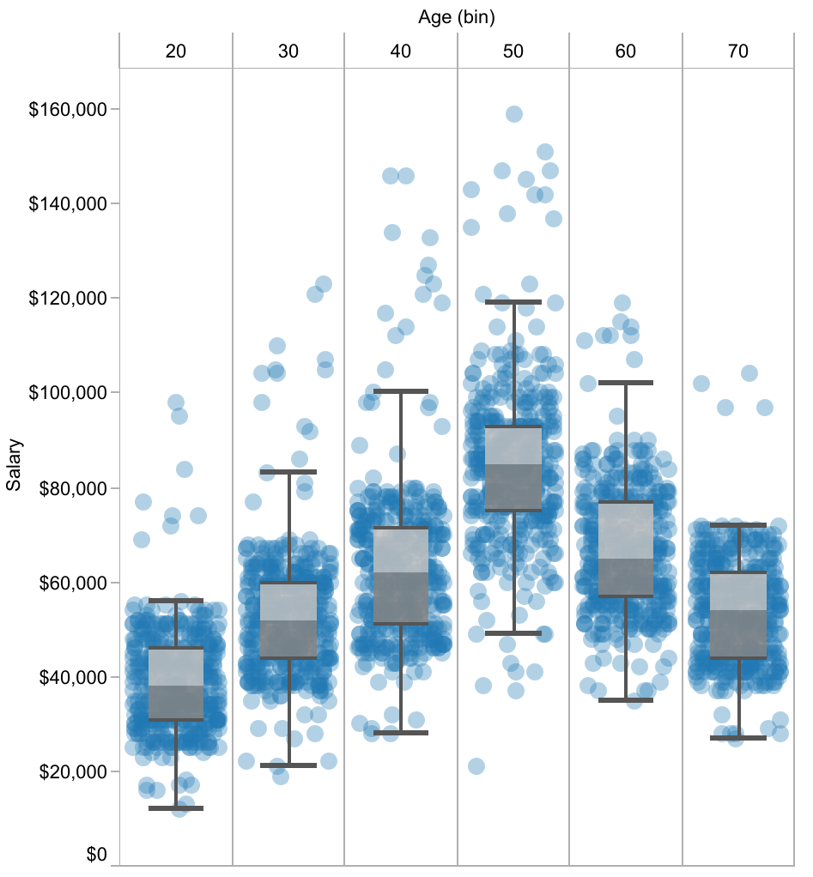
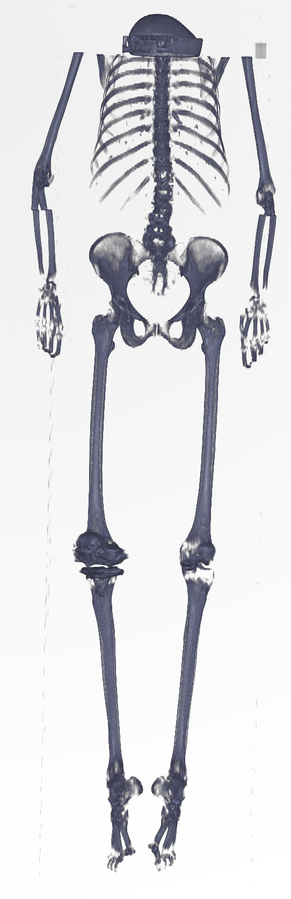
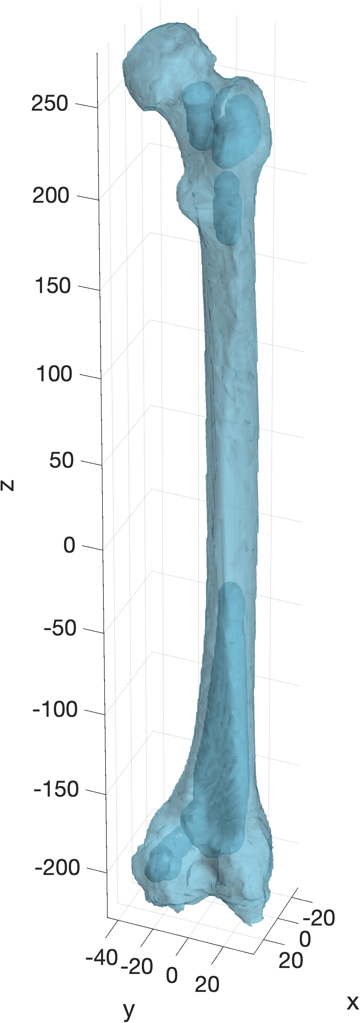



For the Title, use a Large Font Size that you can read from afar
First Your Name, Then people who helped (not necessarily committee members), Then your Mentor
Modern Human Anatomy Program, University of Colorado School of Medicine, Aurora, CO 80045
Background and rationale
More Methods or Results
Results
    Keep it Simple
Connections to Previous Literature
                Incidence rates
Clearly state Rationale: we know this and this, but we don’t know this.
Include Explanatory figure of anatomy involved in your project
  Overall objective
Use Explanatory headers and Large Interesting images
Even more pictures
RNS Probe Implant Analysis
3D Printed models as surgical guides
Medical Volumes: MRI and PET cross-sections of the human brain
Segmentation of the bones in a human skeleton
Mitchondrial Sholl Analysis
Vascular anastomoses Game
Hypothesis: Explicitly state your hypothesis
Discussion
Data Analysis
Summarize Results in easy to understand English
Use Bullet Points
  Use sentence Fragments
Project approach
Salary peaks at age 50
Summarize the methodology and/or analysis you used. Make as picture-based as possible Use logos of software, or timelines, or Biorender, or all of the above.
Femurs longer in Males
Future Directions
State a few bullets on potentiation future directions
Step 1
Step 2
Step 3
femur length = 508 mm
Use Logos for Software
Acknowledgements
Committee Member Names
MHA
NIH Funding
COMIRB / IACUC authorization numbers
QR Codes
Master of Science in Modern Human Anatomy Program • your.email@cuanschutz.edu
Notes:
MATLAB
Campus license, simple install
works on Macs and PCs
Great IDE and Documentation
Ability Incorporate my own docs
MATLAB drive for sharing class resources
Fiji
Powerful Image Processor
Opensource
used by many labs here on campus
3D Slicer
Powerful 3D volume growers
Powerful Manual Segmenter
Opensource
used by many labs here on campus
Offers used Medical Dataset Samples

